Slide 1
CHAPTER 3:
Entity Relationship (ER) Modeling
(Extra Example)
DCI2033 – DATABASE SYSTEMS

Slide 2
Learning Outcomes
Student should be able to:
  Describe the main characteristics of entity relationship components
  Describe business rules and how they influence database design
  Describe relationships between entities - defined, refined, and incorporated into the database design process
  Describe how ERD components affect database design and implementation
  Describe that real-world database design often requires the reconciliation of conflicting goals
Database Systems, 8th Edition

Slide 3
Example: Tiny College

Slide 4
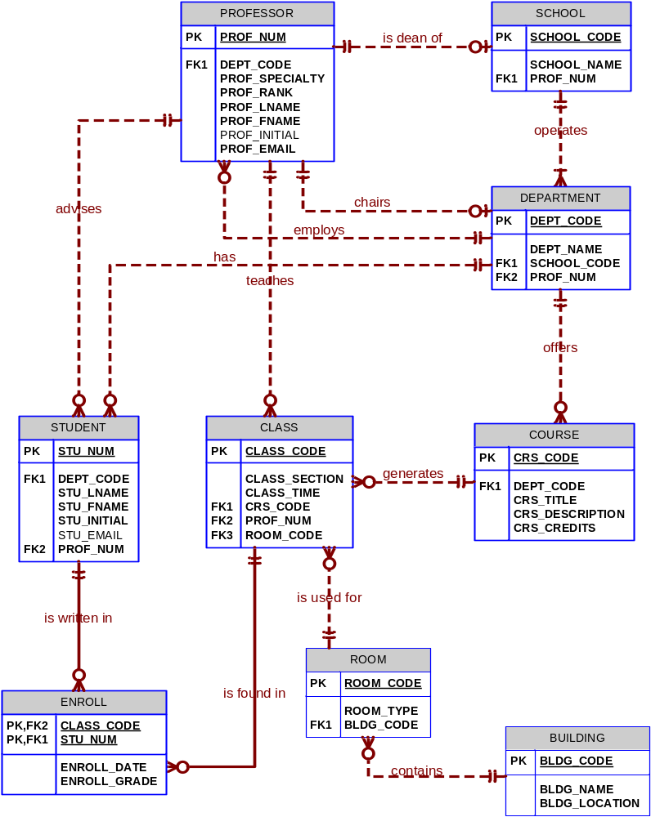
Figure 4.35:
The completed Tiny College ERD

Slide 5
Example: Tiny College
Business Rules 1:
  Tiny College (TC) is divided into several schools: a school of business, a school of arts and sciences, a school of education, and a school of applied sciences. Each school is administered by a dean who is a professor. Each dean can administer only one school. Therefore, a 1:1 relationship exists between PROFESSOR and SCHOOL.
    Note that the cardinality can be expressed by (1,1) for the entity PROFESSOR and by (1,1) for the entity SCHOOL. (The smallest number of deans per school is one, as is the largest number, and each dean is assigned to only one school)

Slide 6
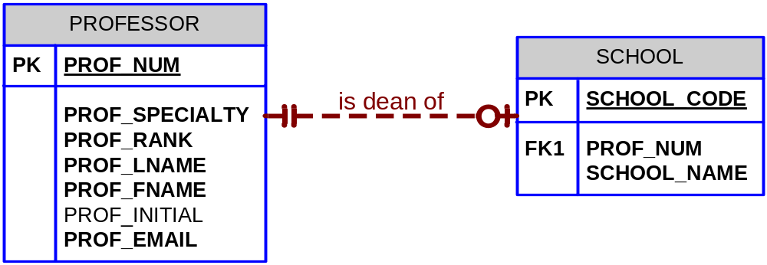
Tiny College: 1st Segment BR1

Slide 7
Example: Tiny College (2)
Business Rules 2:
  Each school is composed of several departments. For example, the school of business has an accounting department, a management/marketing department, an economics/finance department, and a computer information systems department. Note again the cardinality rules: the smallest number of departments operated by school is one, and the largest number of departments is indeterminate (N). On the other hand, each department belongs to only a single school; thus, the cardinality is expressed by (1,1). That is, the minimum number of schools that a department belongs to is one, as is the maximum number

Slide 8
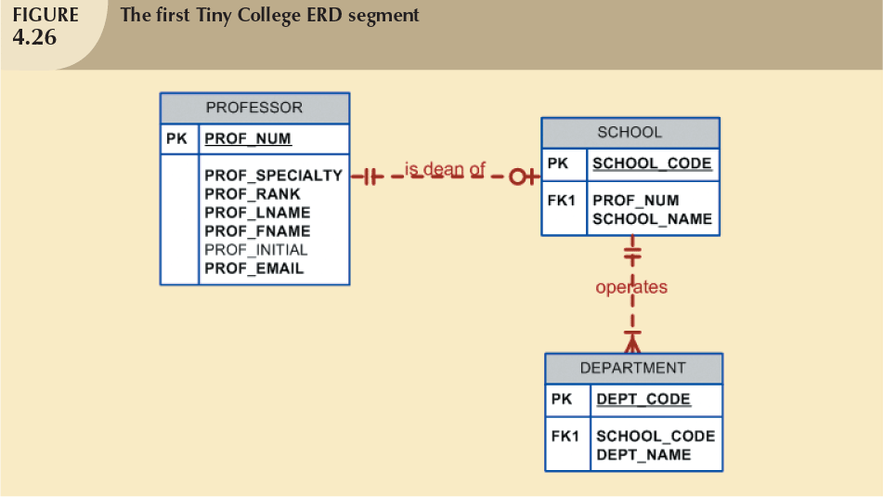
Example: Tiny College – BR2
Database Systems, 8th Edition

Slide 9
Example: Tiny College (3)
Business Rules 3:
  Each department may offer courses. For example, the management/marketing department offers courses such as Introduction to Management, Principles of Marketing, and Production Management. Note that this relationship is based on the way Tiny College operates. If, for example, Tiny College had some departments that were classified as “research only”, those departments would not offer courses; therefore, the COURSE entity would be optional to the DEPARTMENT entity.

Slide 10
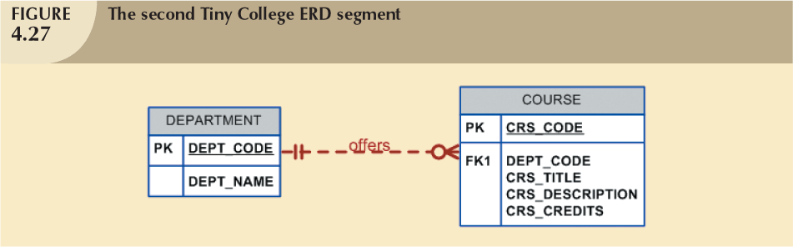
Example: Tiny College – BR3
Database Systems, 8th Edition

Slide 11
Example: Tiny College (4)
Business Rules 4:
  A department may offer several sections (classes) of the same database course. Each of those classes is taught by a professor at a given time in a given place. In short, a 1:M relationship exists between COURSE and CLASS. However, because a course may exist in Tiny College’s course catalog even when it is not offered as a class in a current class schedule, CLASS is optional to COURSE.

Slide 12
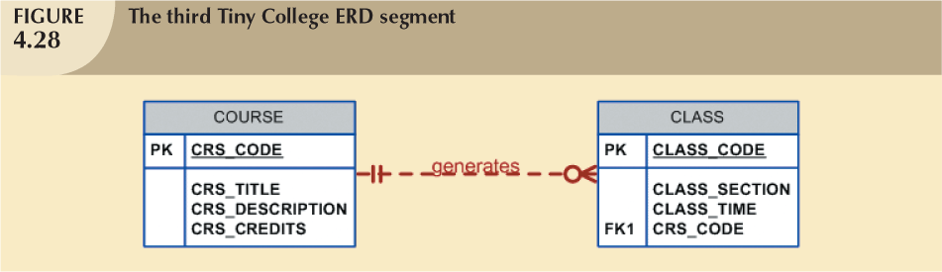
Example: Tiny College – BR4

Slide 13
Example: Tiny College (5)
Each department may have many professors assigned to it. one and only one of those professors chairs the department, and no professor is required to accept the chair position.

Slide 14
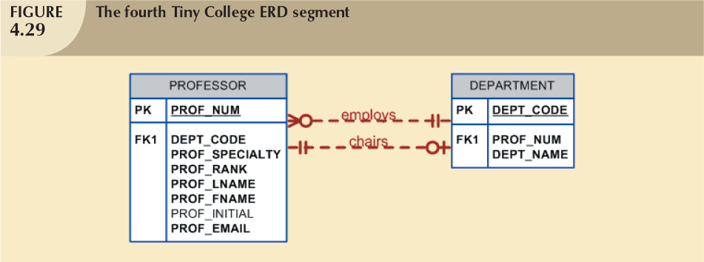
Example: Tiny College – BR5
Database Systems, 8th Edition

Slide 15
Example: Tiny College (6)
Each PROFESSOR may teach up to four classes; each class is a section of a course. A PROFESSOR may also be on a research contract and teach no classes at all.

Slide 16
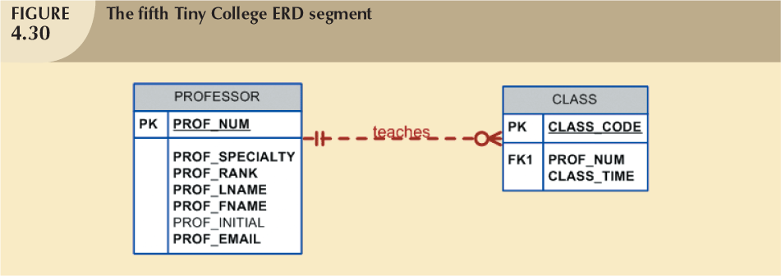
Example: Tiny College – BR6
Database Systems, 8th Edition

Slide 17
Example: Tiny College (7)
A STUDENT may enroll in several classes but takes each class only once during any given enrollment period. For example, during the current enrollment period, a student may decide to take five classes – Statistics, Accounting, English, Database, and History – but that student would not be enrolled in the same Statistics class five times during the enrollment period.
Each student may enroll in up to six classes, and each class may have up to 35 students, thus creating an M:N relationship between STUDENT and CLASS. Because a CLASS can initially exist (at the start of the enrollment period) even though no students have enrolled in it, STUDENT is optional to CLASS in the M:N relationship.

Slide 18
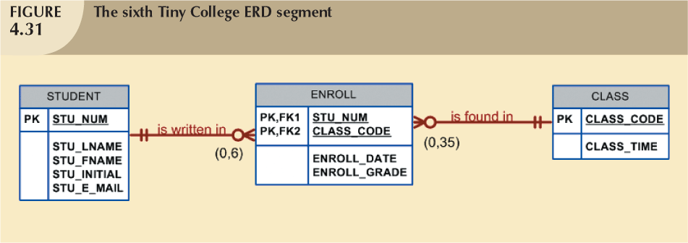
Example: Tiny College – BR7
Database Systems, 8th Edition

Slide 19
Example: Tiny College (8)
Each department has several (or many) students whose major is offered by that department. However, each student has only a single major and is, therefore, associated with a single department.

Slide 20
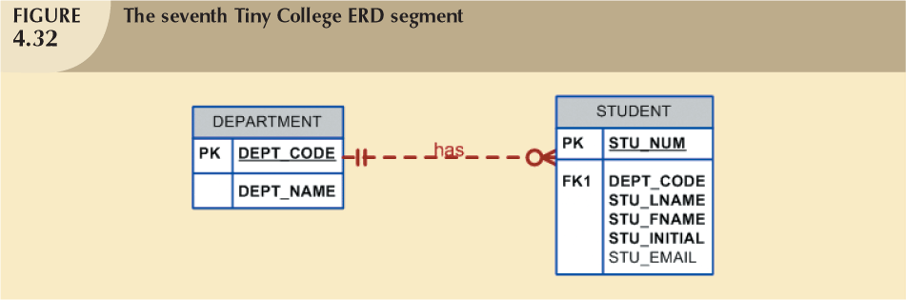
Example: Tiny College – BR8
Database Systems, 8th Edition

Slide 21
Example: Tiny College (9)
Each student has an advisor in his or her department; each advisor counsels several students. An advisor is also a professor, but not all professors advise student.

Slide 22
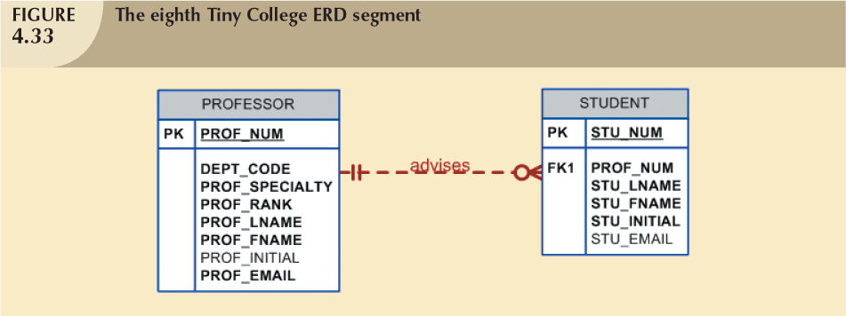
Example: Tiny College – BR9
Database Systems, 8th Edition

Slide 23
Figure 4.35:
The completed Tiny College ERD

Slide 24
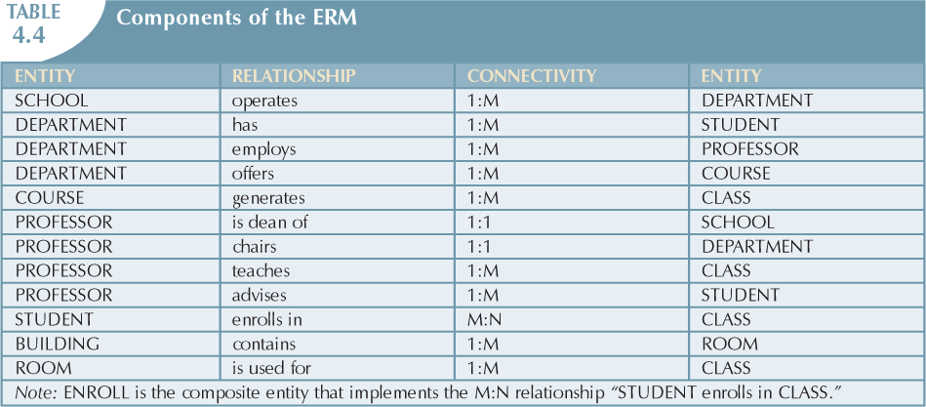
Database Systems, 8th Edition

Slide 25
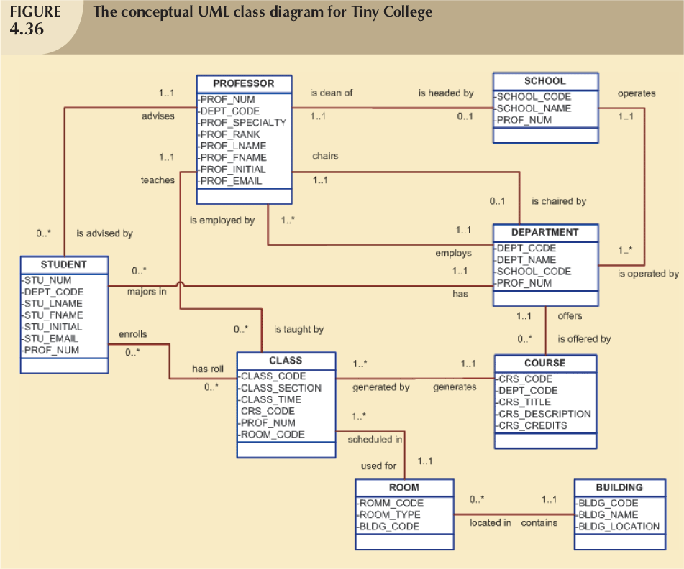
Database Systems, 8th Edition

Slide 26
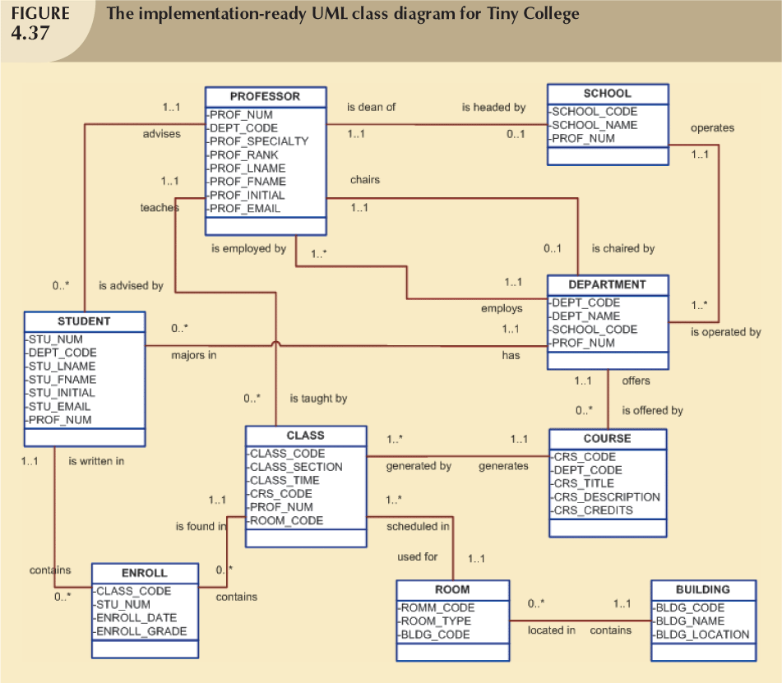
Database Systems, 8th Edition

Slide 27
Database Design Challenges:
Conflicting Goals
Database designers must make design compromises
  Conflicting goals: design standards, processing speed, information requirements
Important to meet logical requirements and design conventions
Design of little value unless it delivers all specified query and reporting requirements
Some design and implementation problems do not yield “clean” solutions
Database Systems, 8th Edition

Slide 28
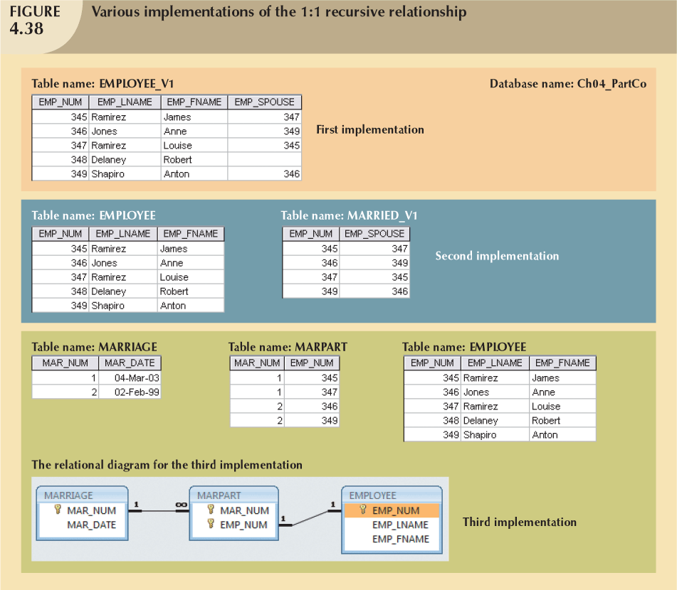
Database Systems, 8th Edition

